Slide 1
STEGANOGRAPHY PROJECT
CAPSTONE PROJECT
Student Name : ROHIT GHOSH
College Name: HERITAGE INSTITUTE OF TECHNOLOGY, KOLKATA
Department : MASTERS OF COMPUTER APPLICATION (MCA)

Slide 2
OUTLINE
Problem Statement
Technology used
Wow factor
End users
Result
Conclusion
Git-hub Link
Future scope

Slide 3
Problem Statement
Data security and privacy are major concerns in the digital world.
Traditional encryption methods are effective but often raise suspicion.
Solution: Steganography—hiding information within images to ensure secrecy and discretion.

Slide 4
Technology used
Programming Language: Python
Libraries:
PIL (Pillow) - for image processing
Flask - for web-based encryption and decryption
HTML, CSS, JavaScript - for the UI
Steganography Method: Least Significant Bit (LSB) manipulation

Slide 5
Wow factors
Seamlessly hides secret messages inside images without altering visual quality.
Users can upload, encrypt, and decrypt messages via a simple web interface.
Works with common image formats like PNG and JPEG.

Slide 6
End users
Journalists & Activists: Secure communication in restrictive environments.
Military & Intelligence Agencies: Covert messaging for operations.
General Public: Personal data protection from unauthorized access.

Slide 7
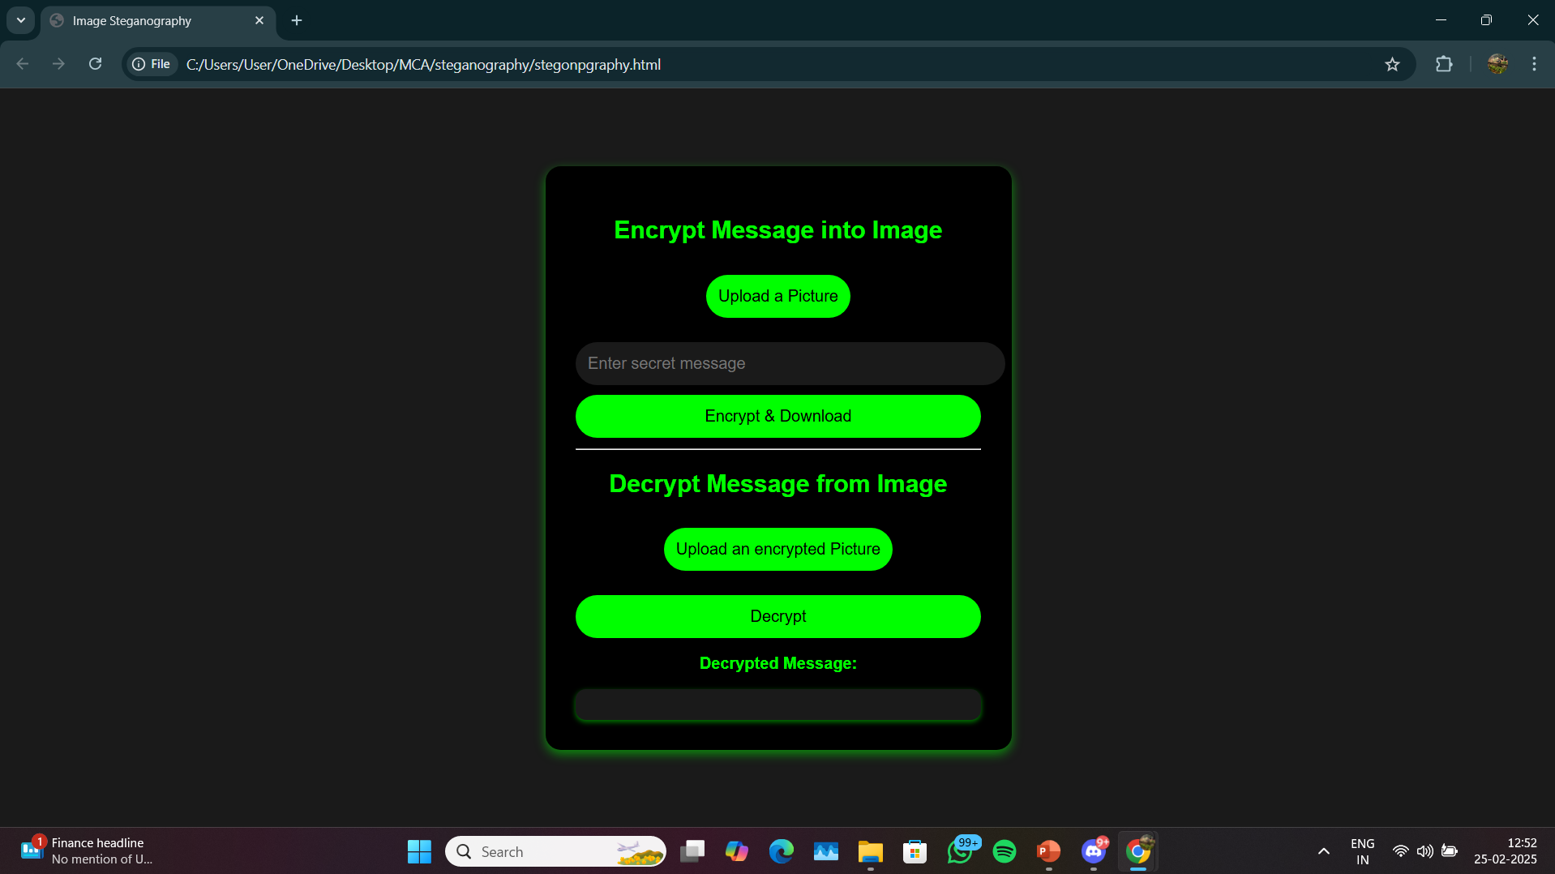
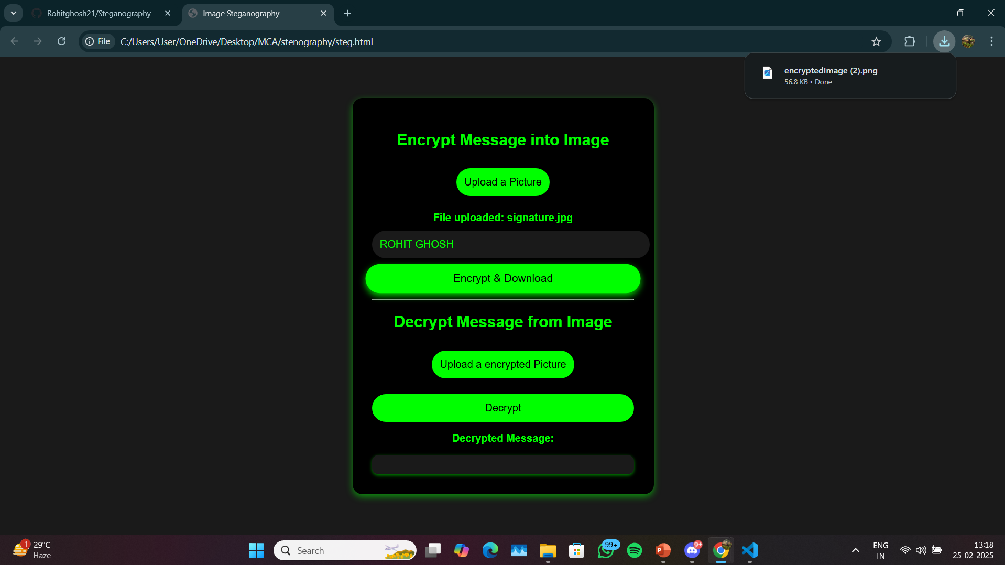
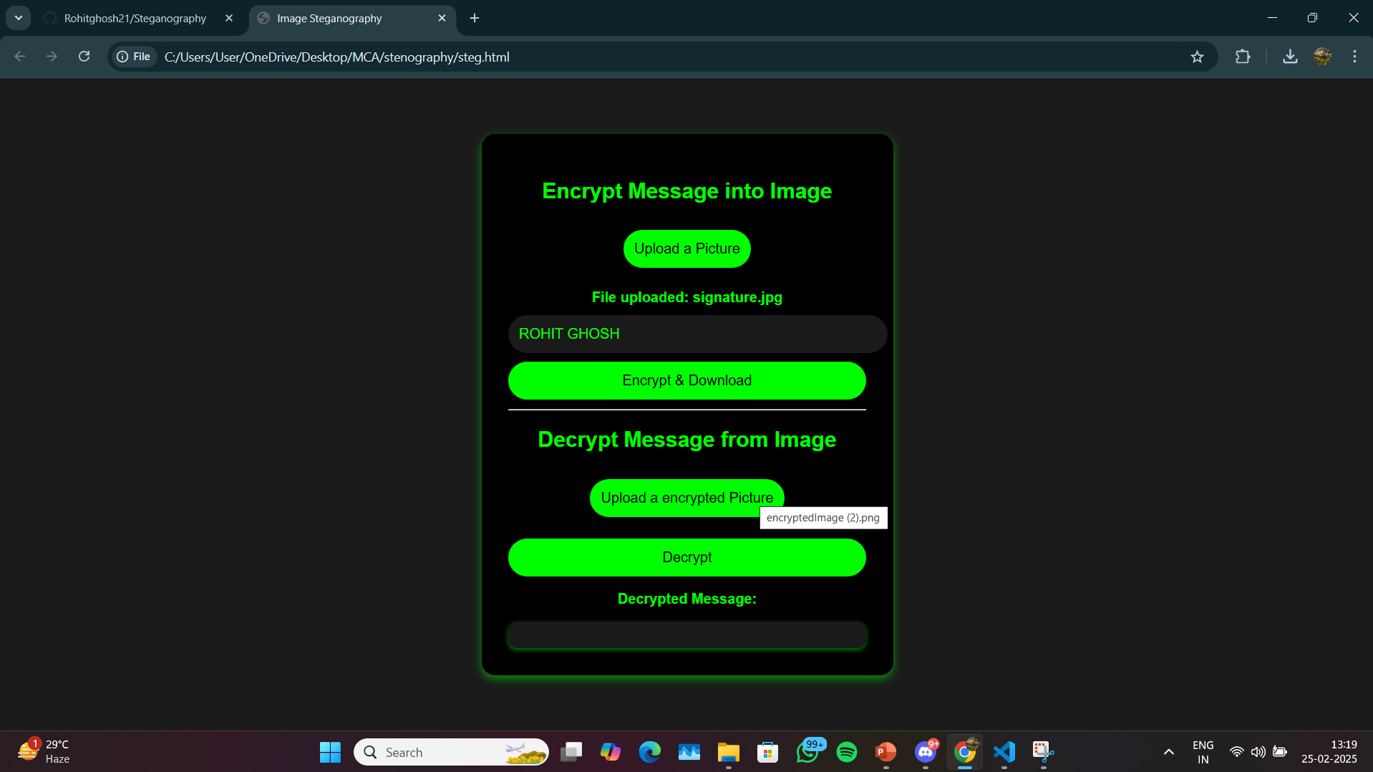
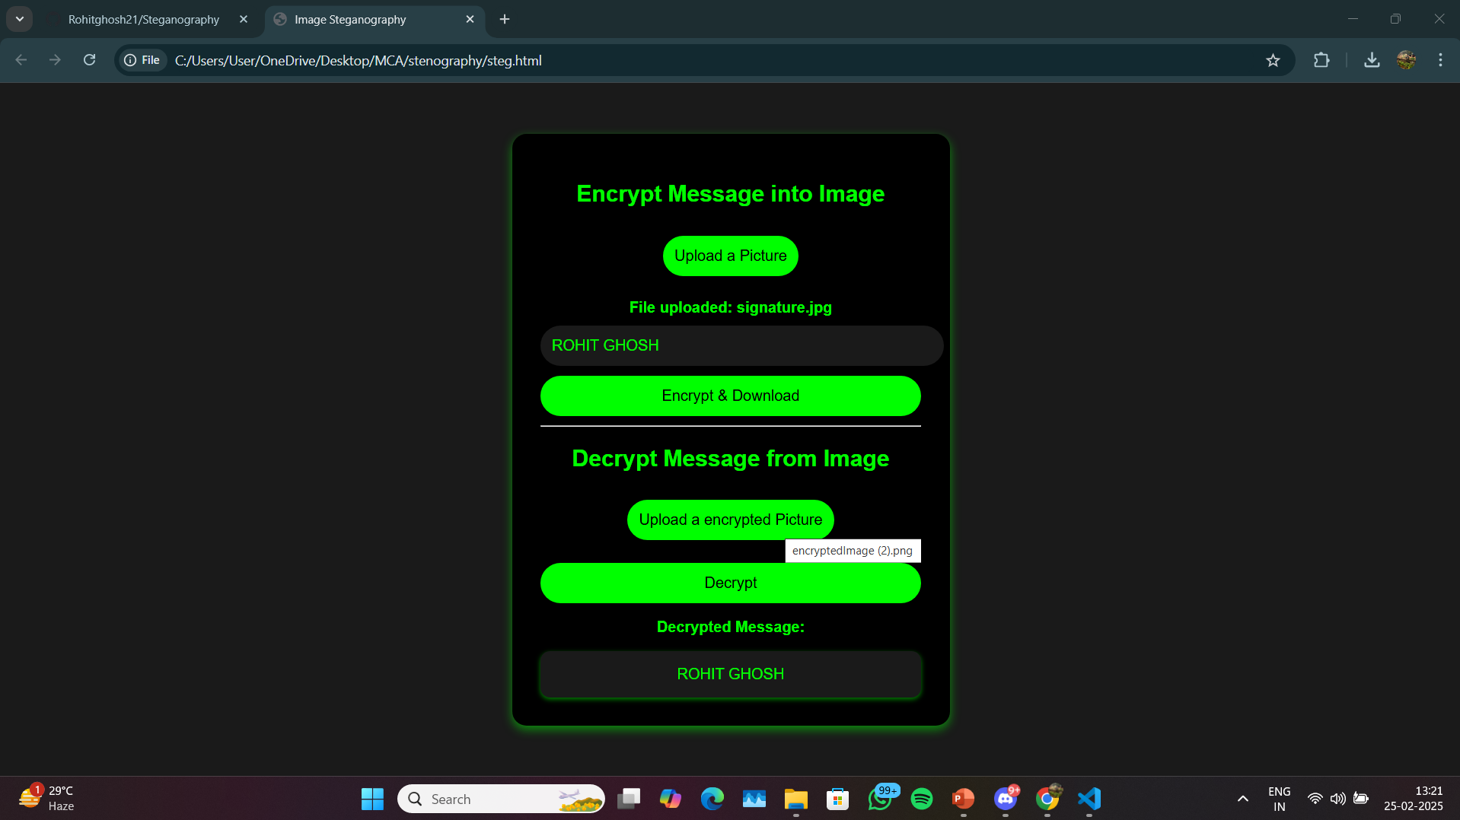
Results

Slide 8
Conclusion
Demonstrates the practical application of steganography for secure communication.
Future Improvements: Enhance security by combining with encryption techniques.

Slide 9
GitHub Link
LINK: https://github.com/Rohitghosh21/Steganography.git

Slide 10
Future scope(optional)
Audio & Video Steganography: Extend the concept beyond images.
Mobile Application: Develop an Android/iOS app for better accessibility.
AI-based Detection Resistance: Improve encoding to bypass AI-based detection methods.

Slide 11
THANK YOU

